Slide 1
EDITING

Slide 2
EDITING
Editing creates the illusion that a film is unfolding naturally, without the intervention of the film-maker. Good editing is invisible with seamless connecting shots that create the illusion of continuity of time and space.

Slide 3
Another purpose of Editing is to either increase or decrease time…
TO COLLAPSE AND SPEED UP TIME
This includes scenes in films such as montages - we see a lot of quick shots of something that might have occurred in the story world over months and we the audience see it in a matter of minutes. This also includes Fast Paced Cuts
TO EXPAND AND SLOW DOWN
This is when time is slowed down. This give the audience a moment to stop and take in what has just happened. This is a common edit technique when something dramatic had just happened. This involves Slow Mo, Longer Cuts Think of major fight scenes in films. As the punch is blown the film slows down so we the audience can take it all in.

Slide 4
Editing Techniques…
Editing is completed in post production and it is when the film is put together.
CUT: this is one of the most common edits, cuts from one shot to another. If a sequence has lots and lots of cuts this can be referred to as quick cuts.
JUMP CUT: this technique is used when the subject is in motion and the camera stays in the same position. A subject is in motion and we the audience see the subject 'jump' forward.
FADE: there are a few fades. Fade in: Screen is black/white and slowly the image begins to appear. Fade out: Screen has the image and slowly begins to disappear into black or white.
DISSOLVE: Similar to a fade but instead of fading to black or white - the screen dissolves from one scene to another.
WIPE: The screen wipes from one side to another.
SPLIT SCREEN: The screen has multiple frames in view.
CROSS CUTTING: multiple events are occurring at the same time and the edits keep cutting between these multiple scenes

Slide 5
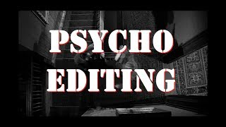

Slide 6
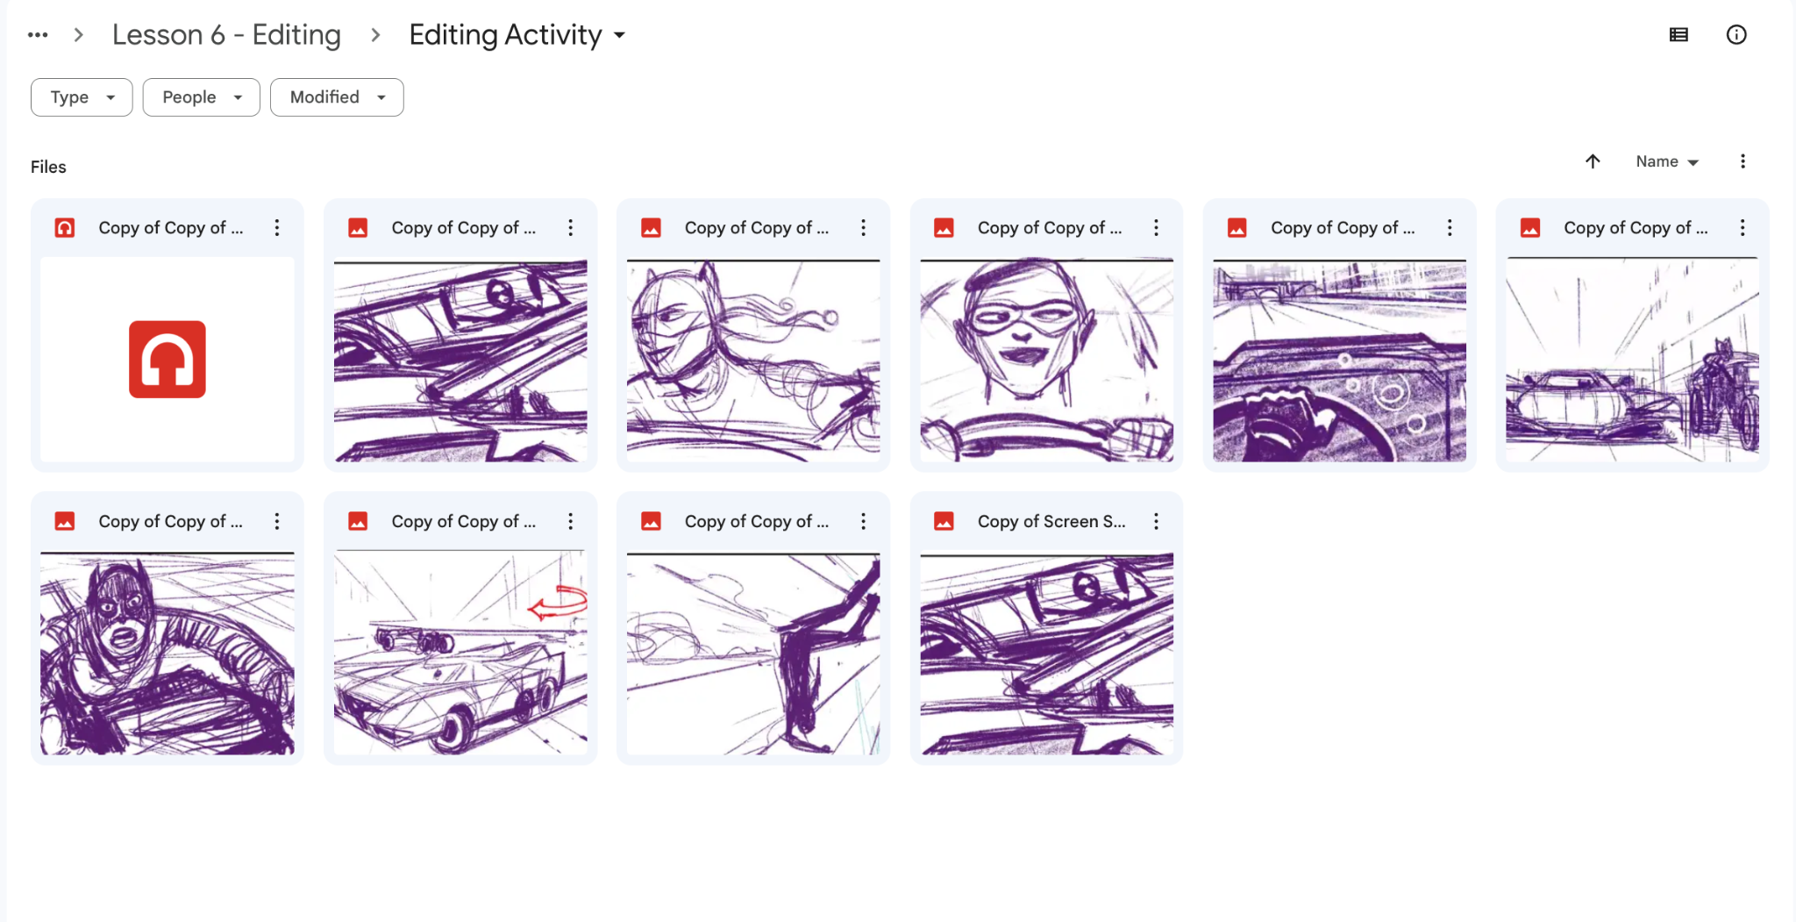
ACTIVITY 1: EDIT THIS SEQUENCE USING CAP CUT ON CAP CUT AND CHANGE ITS PACE WITH THE KNOWLEDGE FROM THE PREVIOUS SLIDES

Slide 7
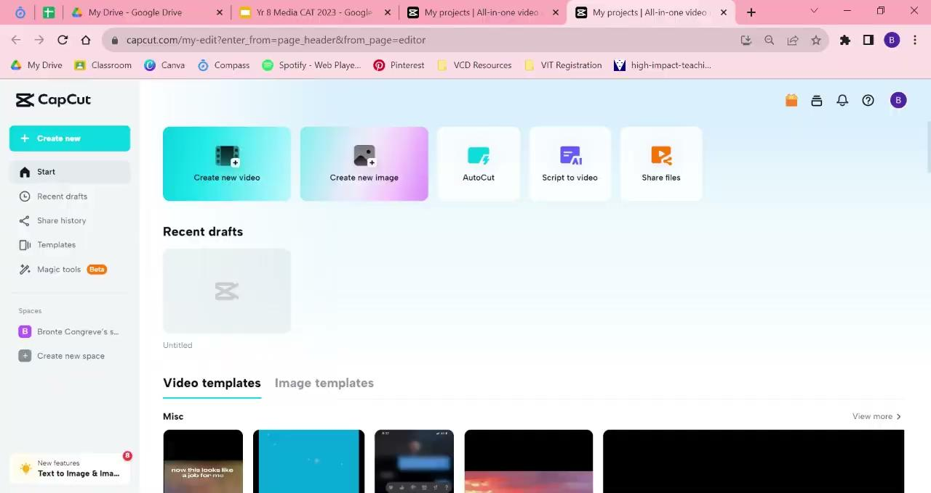
Cap Cut Tutorial By BCO

Slide 8
ACTIVITY 2 - MODERN ‘SHORT FILM’
In groups, use create a 1 minute video that demonstrates your awesome editing skills and knowledge. You can use a phone to film and edit your video!** You can use whatever editing software they wish on their phone (tik tok, instagram, capcut, splice etc. or imovie) - just make sure you do not post it!
We will share these as a class together and post them on Google Classroom.
*ONE phone per group - any extra phones will be confiscated.

Slide 9
VIDEO PROMPT
Create a thriller/horror inspired 1 minute short film about school. This could be an ironic take on ‘the horrors’ of school or you could make up a fake scenario. 1. Create a quick storyboard together and work through your ideas of how you are going to shoot your short film. What shots you will take.
2. Create a script (If you need one… it could have no talking if the editing was great!)
3. Edit in your chosen program TOGETHER. Make sure everyone is involved. 4. Share video to the Google Classroom assignment for your teacher to see/ share with the class.

Slide 10
Some inspiration for you…
Watch the following 1 minute videos to inspire you to create your own short films!

Slide 11
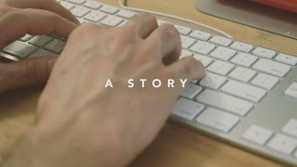

Slide 12
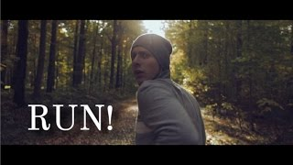

Slide 13
