Slide 1
Verbs
A verb is a word that expresses an action or a state of being
You may know them as ‘doing words’
However not all verbs are easily identifiable as action and sometimes the subjects in sentences are not necessarily performing a physical action! We will now talk about two different types of verbs!

Slide 2
Action Verbs
An action verb is used to describe an action that is performed
For example:
Damon ran outside.
Luella eats chocolate cake on Sundays.
Kiri skips and jumps at recess time

Slide 3
However not all verbs are easily identifiable as action! Some do not represent a physical action or movement being made.
Miss B knows your name
Ollie thought about playing fortnight
All of the Grade 2s considered eating pizza for dinner.
These are Non-Action Verbs, i.e. they do not refer to an action as such, but represent a state of being, need, opinion, sense, or preference.
Lucy loves dinosaurs.
Marlee feels happy about the day ahead
George needs more sleep to pass the level on his favourite favourite computer game!

Slide 4
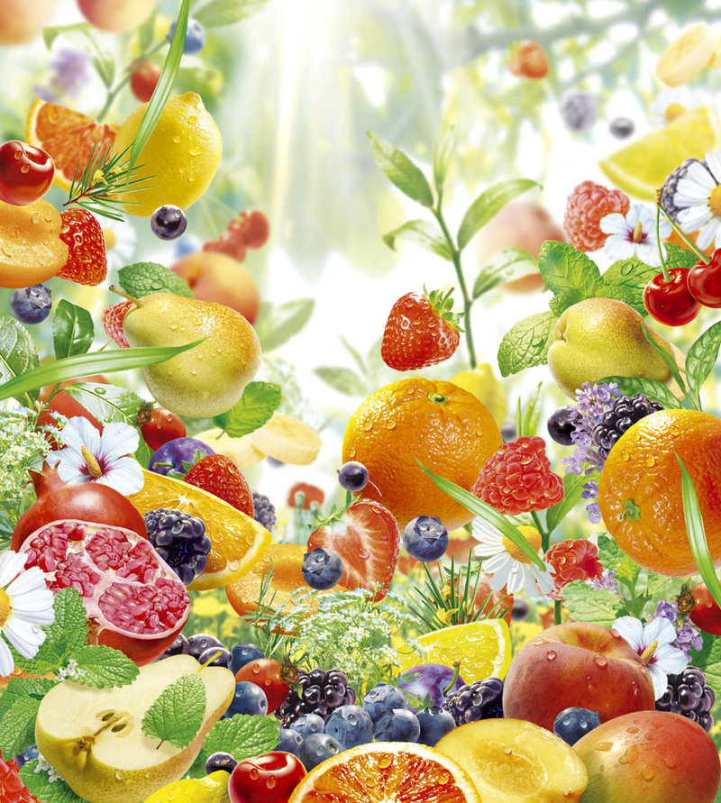
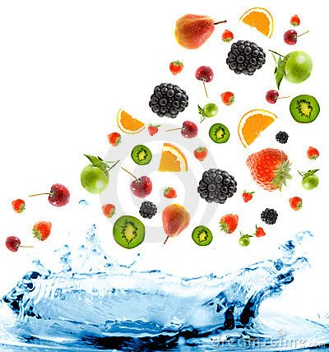
On a sunny afternoon, a boy named Dominic walked to the shops to buy special seeds to plant magical trees. Dominic walked through the entrance doors, and reached for a packet of seeds on the shelf. Dominic shook the bag to hear all the magical seeds in the packet. Dominic thought about getting another packet because he wants magical trees to grow everywhere in his backyard. Dominic grabbed another packet off the shelf, paid for the seeds and left. Dominic because he was so excited to plant the seeds ran all the way home! When Dominic got home, he sat down to have a rest before beginning to plant.
After his rest, Dominic dug 200 wholes in the ground and planted 200 seeds! All of a sudden the trees rapidly grew! They were making loud noises and moving up high in the sky! Dominic felt scared, because he didn’t like the loud noises they were making. Dominic imagined what could be at the very top of the trees because he could see them rattling around.

Slide 5
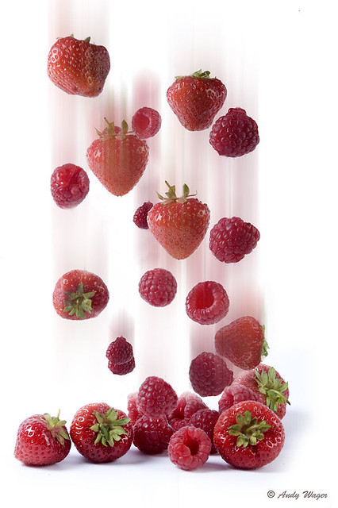
Apples, Oranges, pears, apricots and plums then fell from the trees like it was raining! Dominic wanted to catch them all in a bucket, so he ran inside and got one and started to catch them all! Dominic thought that the magical seeds were the best magical seeds ever! Dominic loves fruit, but he loved them even more now that it will forever be raining a fruit salad!
Dominic after collecting a bucket full of different fruit, decided to make a fruit pie will all the different fruits he collected!
After making the fruit pie, Dominic invited all his friends over to share it with them.
He knew that they loved the pie by all the smiles on their faces!

Slide 6
On a sunny afternoon, a boy named Dominic walked to the shops to buy special seeds to plant magical trees. Dominic walked through the entrance doors, and reached for a packet of seeds on the shelf. Dominic shook the bag to hear all the magical seeds in the packet. Dominic thought about getting another packet because he wants magical trees to grow everywhere in his backyard. Dominic grabbed another packet off the shelf, paid for the seeds and left. Dominic because he was so excited to plant the seeds ran all the way home! When Dominic got home, he sat down to have a rest before beginning to plant.
After his rest, Dominic dug 200 wholes in the ground and planted 200 seeds! All of a sudden the trees rapidly grew! They were making loud noises and moving up high in the sky! Dominic felt scared, because he didn’t like the loud noises they were making. Dominic imagined what could be at the very top of the trees because he could see them rattling around.
Apples, Oranges, pears, apricots and plums then fell from the trees like it was raining! Dominic wanted to catch them all in a bucket, so he ran inside and got one and started to catch them all! Dominic thought that the magical seeds were the best magical seeds ever! Dominic loves fruit, but he loved them even more now that it will forever be raining a fruit salad!
Dominic after collecting a bucket full of different fruit, decided to make a fruit pie will all the different fruits he collected!
After making the fruit pie, Dominic invited all his friends over to share it with them.
He knew that they loved the pie by all the smiles on their faces!

