Slide 1
SOUND

Slide 2
SOUND
What is Diegetic and Non-Diegetic sound?!

Slide 3
Diegetic Sound
Diegetic sound is any sound that comes from the storyworld of the film.
The source of diegetic sound doesn't necessarily need to be seen on screen, as long as the audience understands that it is coming from something within the film.
1. Character dialogue is the clearest example of diegetic sound.
2. Object sounds make a film more realistic. For example, if a character walks in the snow, the audience should hear the crunching of their footsteps. If a character is standing on a busy street, we hear the natural ambiance of the city.
3. Music emanating from within in the film helps the audience become absorbed in a scene. For example, music playing loudly in someone’s headphones, or the pounding dance music at a bar are also diegetic sound. This kind of diegetic sound is also called “diegetic music” or “source music.”

Slide 4
Non-Diegetic Sound
Non-diegetic sound is any sound that does not originate from within the film’s world. The film’s characters are not able to hear non-diegetic sound. All non-diegetic sound is added by sound editors in post-production. 1. The film’s musical score edited over the top is used to set the film’s tone, manipulate emotions, add drama, express ambiguity, or provide an element of surprise.
2. Sound effects are added for dramatic effect. For example, a record scratch sound added for comic relief is not heard by the characters in the film.
3. Narration or voice over is used to help explain or reinforce the plot.

Slide 5
Copy down these notes…
Diegetic Sound Diegetic sound is any sound that comes from the storyworld of the film.
1. Character dialogue
2. Object sounds - Eg. the car engine rumbling, a door closing and making a bang.
3. Music emanating from within in the film - Eg. Music playing loudly in someone’s headphones, dance music at a bar (diegetic music/ source music)
Non-Diegetic Sound Non-diegetic sound is any sound that does not originate from within the film’s world. The film’s characters are not able to hear non-diegetic sound. 1. The film’s musical score - set the films tone, manipulate emotions, add drama, or provide an element of surprise.
2. Sound effects - For example, a record scratch sound added for comic relief is not heard by the characters in the film.
3. Narration or voice over is used to help explain or reinforce the plot.

Slide 6
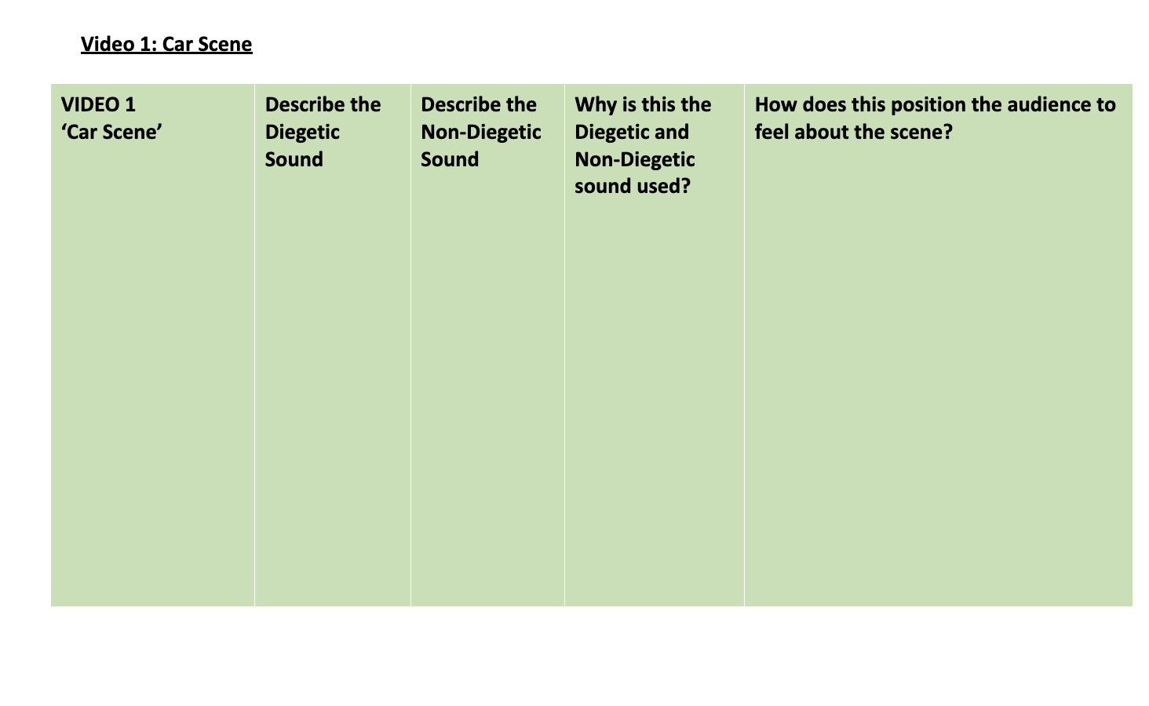

Slide 7
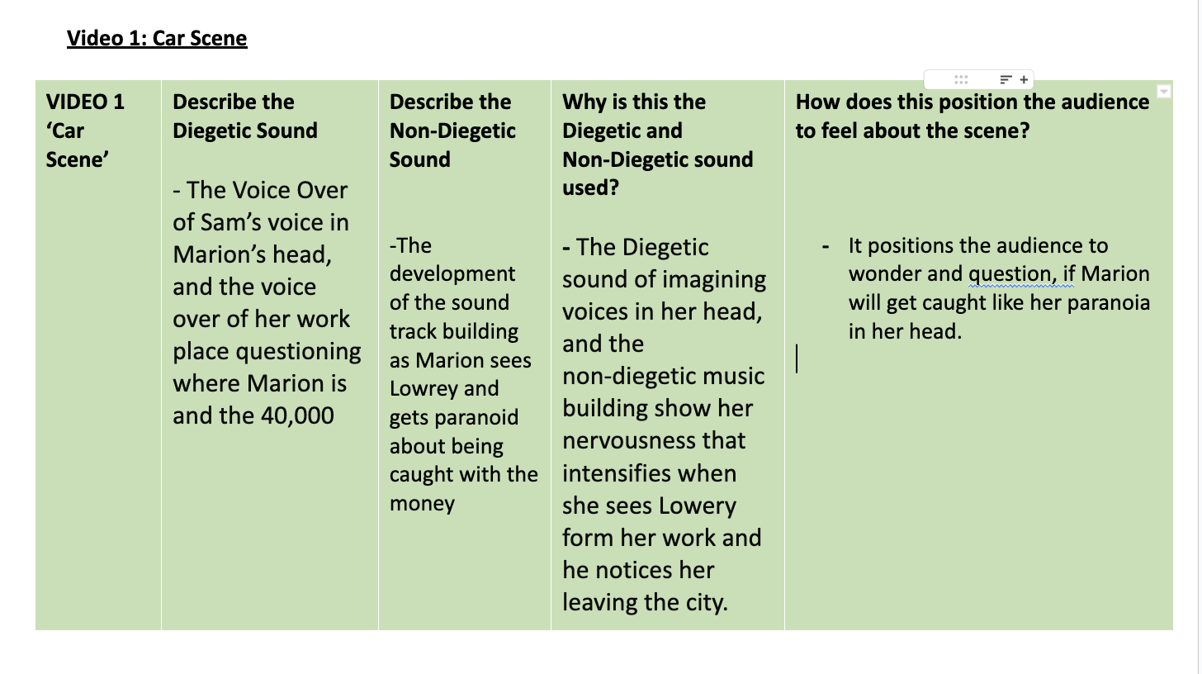

Slide 8
VIDEO 1 ‘Opening Scene’ | Diegetic Sound and where it is shown | Effect/Mood? | Non-Diegetic Sound and where it is shown | Effect/Mood? .

Slide 9
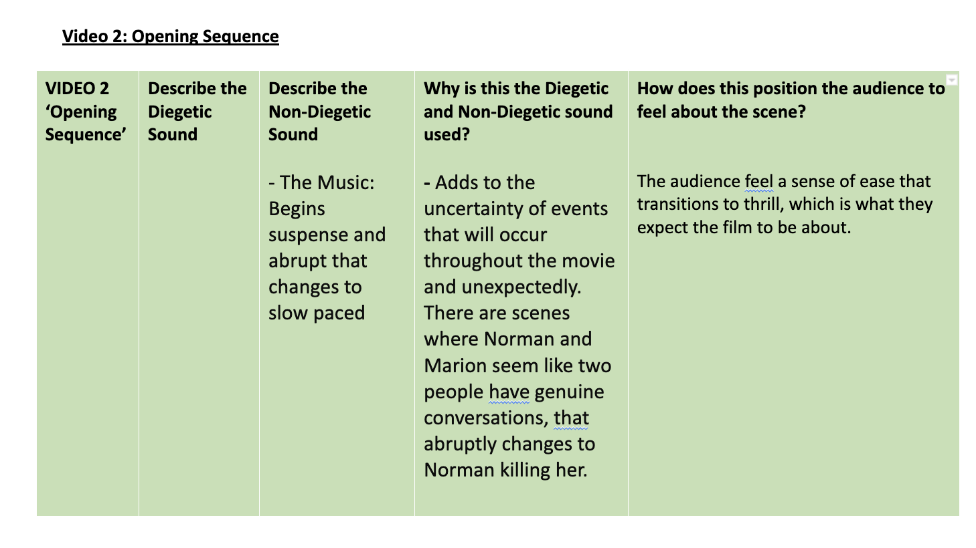

Slide 10
NDWE – Ongoing Booklet Question
“Utilizing the Technical Code Sound, describe how this is used (Diegetic and/or Non-Diegetic) to suggest meaning in the Opening Sequence OR Scene as Marion drives away” (4 marks)
Name – Sound Describe – How you hear it physically Why - Why it is used Effect – How it makes the audience feel
N: The Technical Code of _______ has been used in the scene called ________. D: This has been shown by the Diegetic and/or Non-diegetic sound such as ___________. W: This is used to highlight the importance of _________ E: The overall effect is that the audience ________

Slide 11
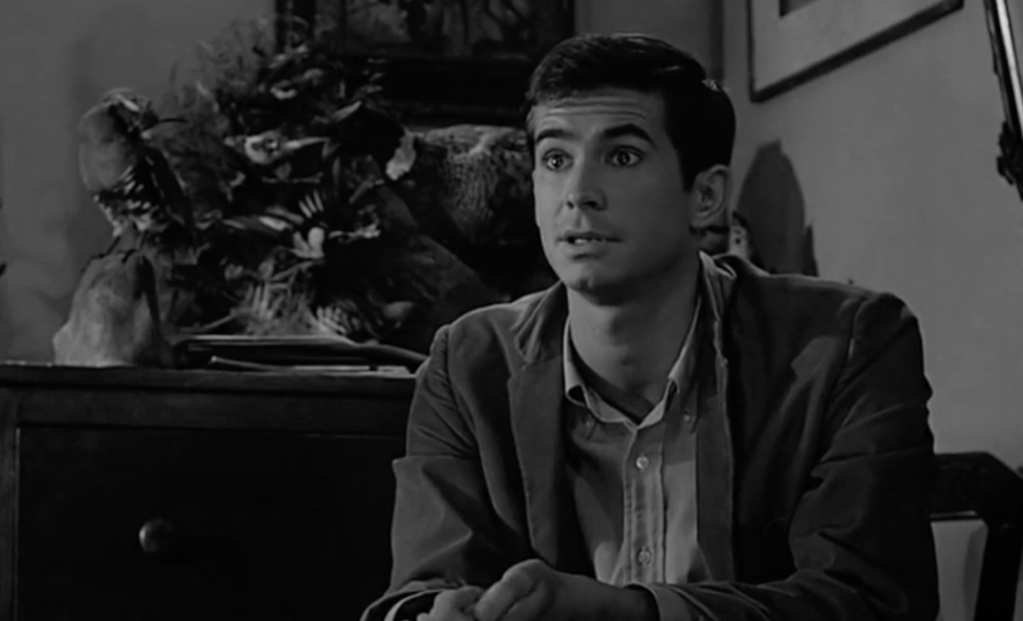
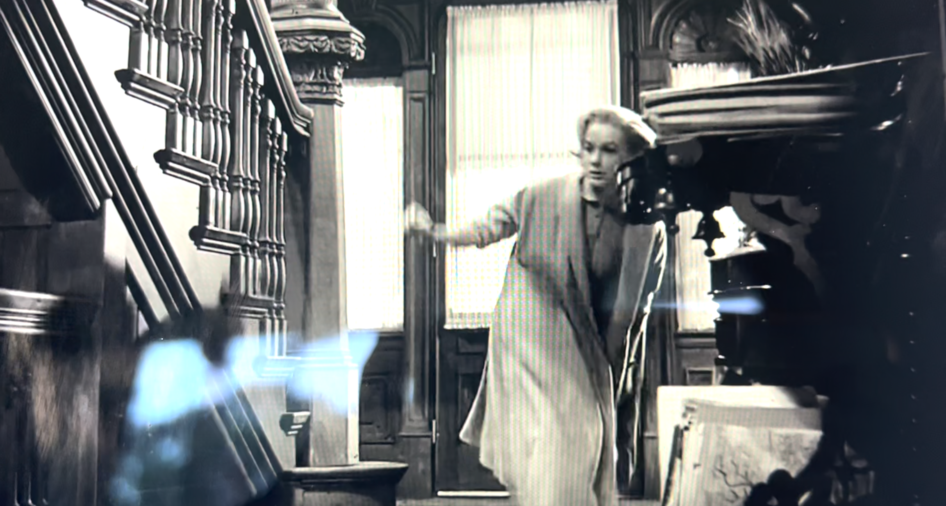
Workbook Question:
N: The Technical Code of _______ has been used in the scene called ________. D: This has been shown by the Lighting such as ___________. W: This is used to highlight the importance of _________ E: The overall effect is that the audience ________

Slide 12
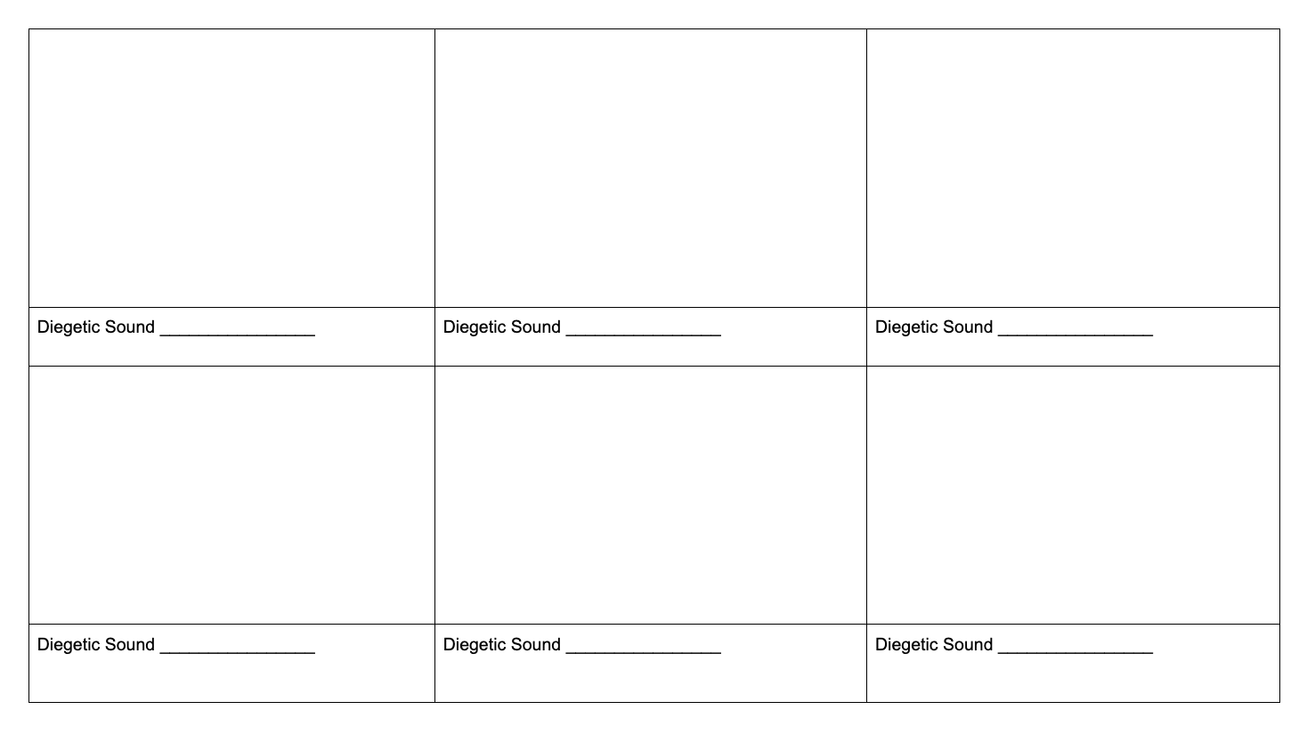
SOUND LIGHTING VIDEO TASK
Create a thriller/horror inspired 1 minute short film about school. This could be an ironic take on ‘the horrors’ of school or you could make up a fake scenario. 1. Create a quick 6 shot storyboard together and work through your ideas of how you are going to shoot your short film. What shots you will take.
2. You must include at least one diegetic sound for each frame, and one mom-diegetic sound for the film (You could narrate what happens, or use a song, or both, get creative!)

Slide 13
3. Create a script (If you need one… it could have no talking if the editing was great!)
4. Edit in your chosen program TOGETHER. Make sure everyone is involved.
5. Share video to the Google Classroom assignment for your teacher to see/ share with the class.

